Slide 1
Images of Climate Change

Slide 2
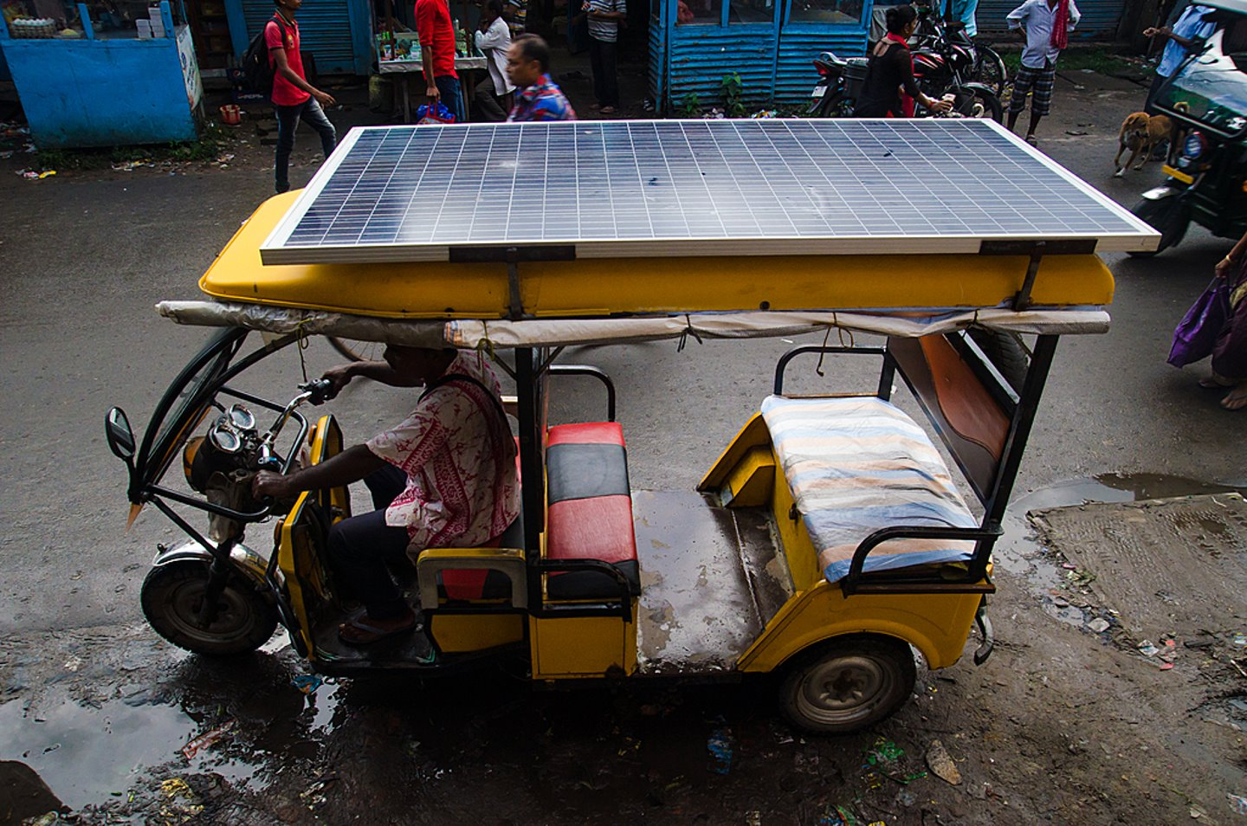
Sustainable Transportation
A man driving a solar-charged rickshaw with a huge solar panel on the roof. This is not only a low-cost vehicle but also has zero pollution.
Location: West Bengal
Photographer: Avijit Ghosh / Climate Visuals Countdown
Notes:
https://climatevisuals.org/

Slide 3
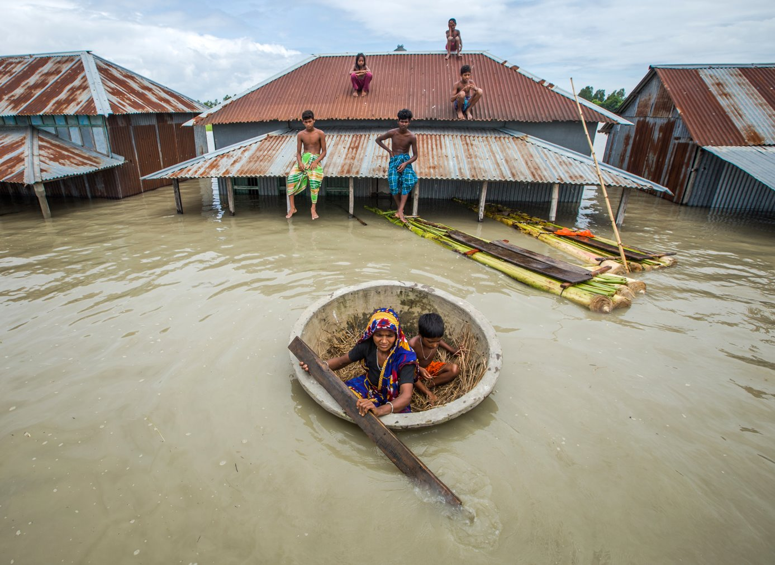
A house almost submerged by flooding
An increased number of floods, due to reduced river gradients, higer rainfall in the Ganges-Meghna-Brahmeputra river basins, and the melting of glaciers in the Himalayas, is considered the major reason for migration in the context of climate change in Bangladesh over all.
Location: Sirajgani, Bangladesh
Photographer: Moniruzzaman Sazal / Climate Visuals Countdown

Slide 4
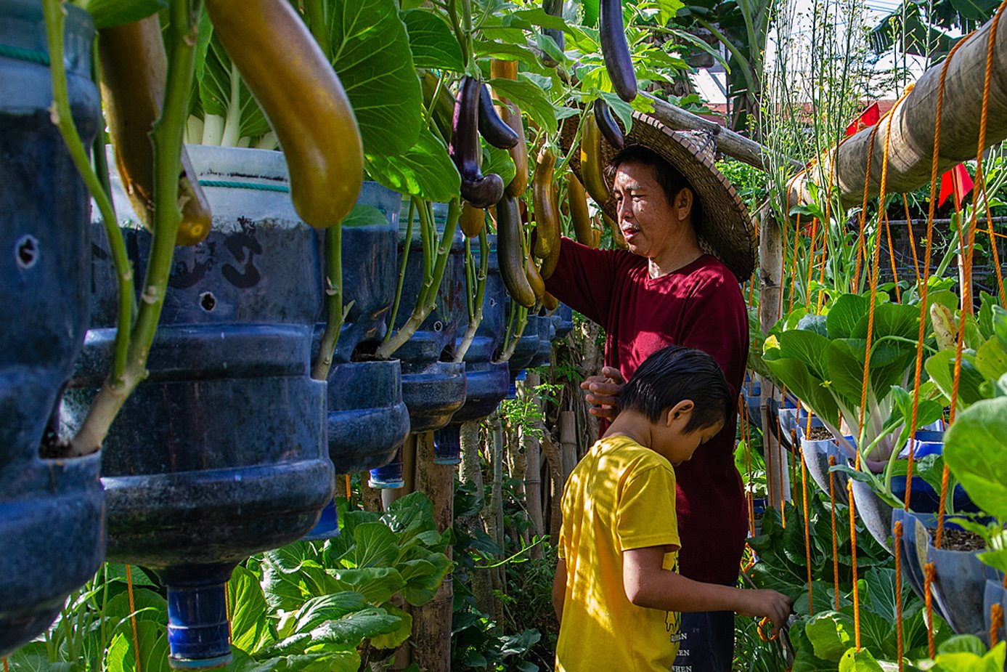
Containerised Gardening
This urban agricultural farm includes more than 25 varieties of vegetable and is good way to recycle plastic containers.
Location: Cebu, Philippines
Photographer: Mark Linel Padecio / Climate Visuals Countdown
Notes:
Planting in recycled containers in an urban space​
Creative Commons: https://climatevisuals.org/groupitem/95/

Slide 5
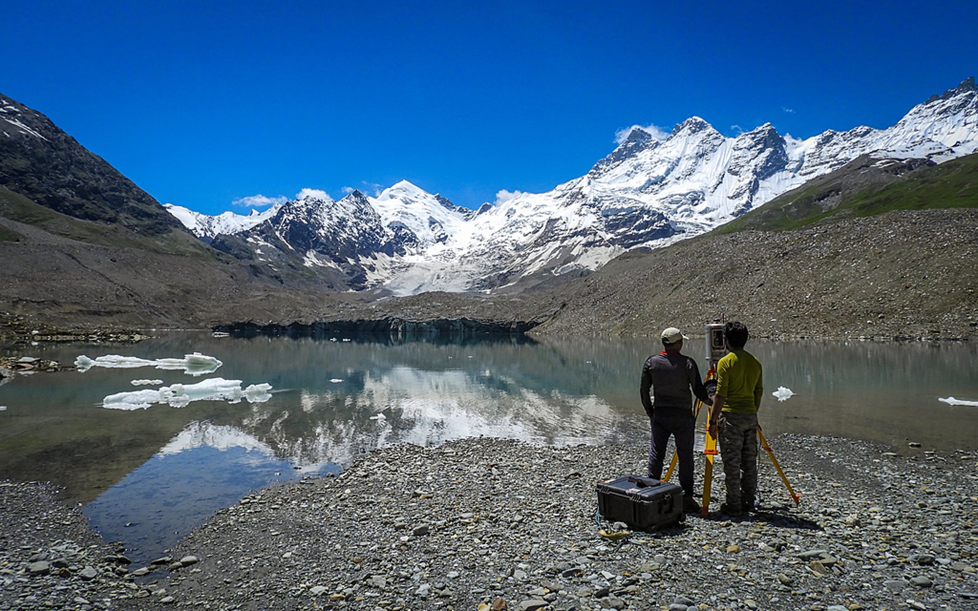
Melting Glaciers
Over the last 40 years, the lake volume has increased by over 20 times due to melting and calving glacier fragments. Glaciologists are regularly monitoring the changes happening on this glacier and the lake due to increasing temperatures caused by climate change.
Location: Himalayas, India
Photographer: Rakesh Rao / Climate Visuals Countdown
Notes:
HERE TODAY, GONE TOMORROW, GLACIOLOGISTS MONITORING THE CHANGES HAPPENING ON THE GEPANG GATH GLACIER AND THE PROGLACIAL LAKE DUE TO INCREASING TEMPERATURES.​
Creative commons: https://climatevisuals.org/groupitem/95/

Slide 6
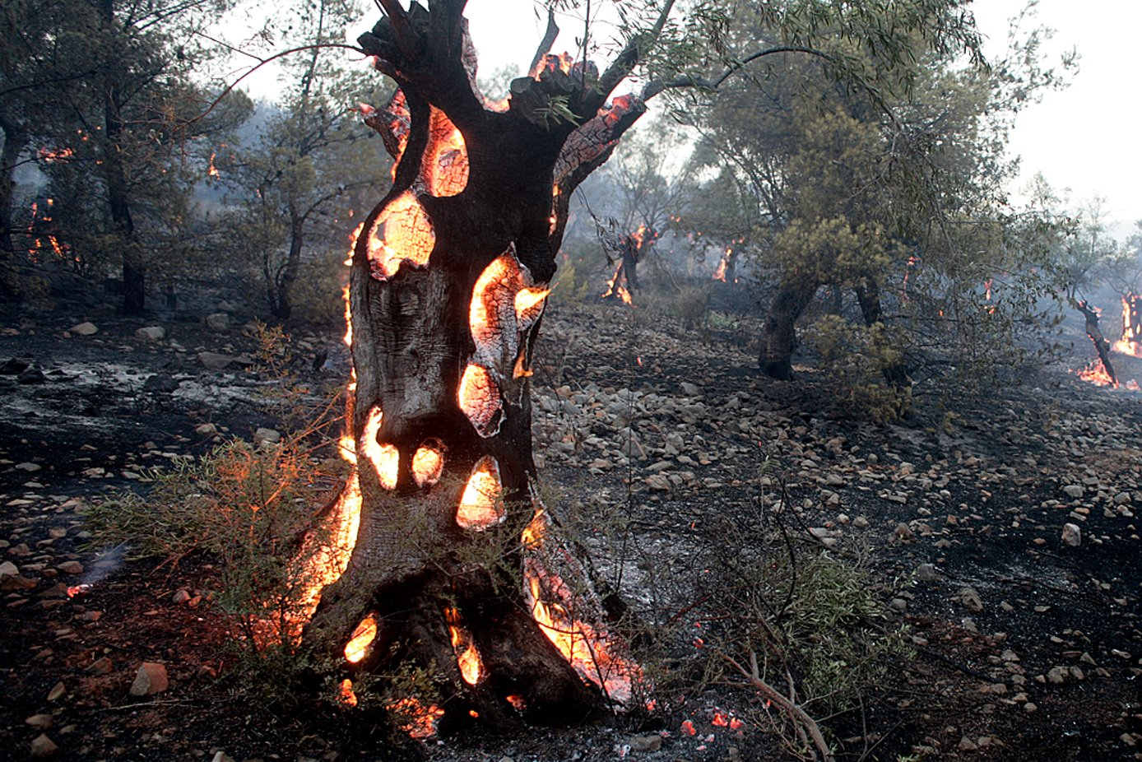
Olive trees burn during a wildfire in Greece
When trees die by fire, they release into the atmosphere the carbon stored within them – a climate feedback loop in which the forests which are typically climate sinks, become carbon sources, releasing the stored gas.
Location: Megara, Greece
Photographer: Milos Bicanski / Climate Visuals Countdown
Notes:
Olive trees burn during a wildfire in Greece. Several hundred year old olive tree burns from inside and that is why it is extremely hard for firefighters to control and extinguish the fire in olive trees fields. When trees die by fire, they release into the atmosphere the carbon stored within them. This is why the effect of wildfires on emissions is among the most feared climate feedback loops.​
Creative commons https://climatevisuals.org/groupitem/95/

